Slide 1
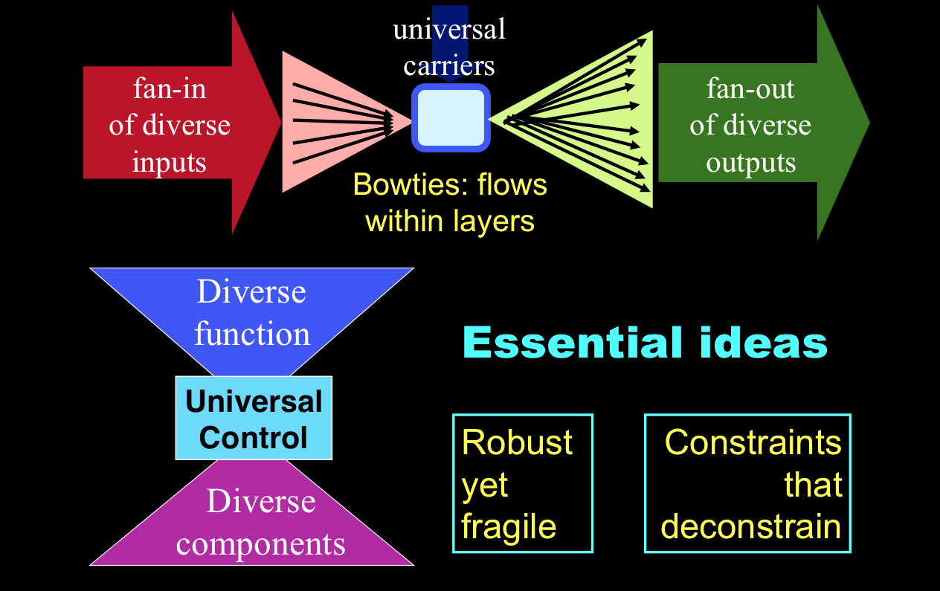
Macro Trends, Complexity, and Software Defined Networking
David Meyer
CTO and Chief Scientist, Brocade
Director, Advanced Technology Center, University of Oregon
AusNOG 2013
Sydney, AU
dmm@{brocade.com,uoregon.edu,1-4-5.net,…}
http://www.1-4-5.net/~dmm/talks/ausnog2013.pdf

Slide 2
Agenda
Introduction
Macro Trends?
Context: SDN Problem Space and Hypothesis
Robustness, Fragility, and Complexity: How does all this fit together?
SDN: How did we get here?
Where is all of this going
  And what role does SDN play?
Summary and Q&A if we have time

Slide 3

Danger Will Robinson!!!
This talk is intended to be controversial/provocative
(and a bit “sciencey”)

Slide 4
Bottom Line Here
I hope to convince you that there are exist “macro
trends”, which when combined with universal
scaling and evolvability properties of complex
systems (networks), are inducing uncertainty and
volatility in the network space, why this is the case,
how SDN is accelerating this effect, and finally,
what we might do to take advantage of it.¹
1 s/take advantage of/survive/ -- @smd

Slide 5

Macro Trends

Slide 6

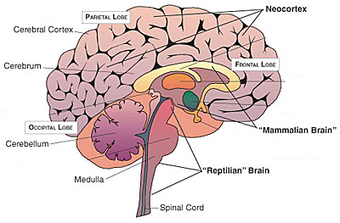
Trend: The Evolution of Intelligence
Precambrian (Reptilian) Brain to Neocortex → Hardware to Software
HARDWARE
SOFTWARE
Universal Architectural Features of Scalable/Evolvable Systems
  RYF-Complexity
  Bowtie architectures
  Massively distributed control
  Highly layered with robust control
  Component reuse
Once you have the h/w
its all about code

Slide 7
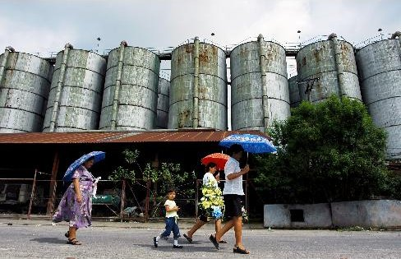
Trend: Everything De-silos
  Vertical -> Horizontal Integration
  Everything Open {APIs, Protocols, Source}
  Everything Modular/Pluggable
  Future is about Ecosystems

Slide 8
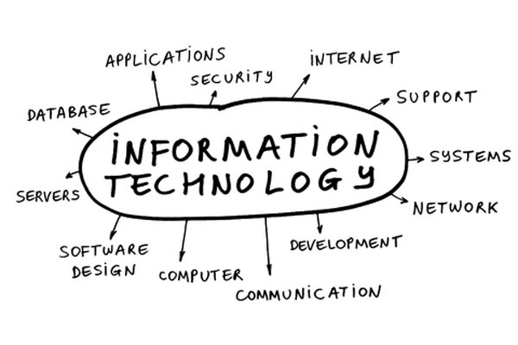
Trend: Network Centric to IT Centric
Shift in influence and speed
Shift in locus of purchasing influence
Changes in cost structures
  ETSI NfV, ATIS, IETF, Open Source, ...
NetOPs → DevOPs

Slide 9
Other Important Macro Trends
Everything Virtualizes
  Well, we’ve seen this
Data Center new “center” of the universe
  Looks like ~ 40% of all traffic is currently sourced/sinked in a DC
  Dominant service delivery point
Integrated orchestration of almost everything
Bottom Line: Increasing influence of software *everywhere*
  All integrated with our compute, storage, identities, …
  Increasing compute, storage, and network “power” → increasing volatility/uncertainty

Slide 10
Oh Yeah, This Talk Was Supposed To Have Something To Do With SDN
Well then, what is the SDN problem space?
Network architects, engineers and operators are being presented with the following challenge:
  Provide state of the art network infrastructure and services while minimizing TCO
SDN Hypothesis: It is the lack of ability to innovate in the underlying network coupled with the lack of proper network abstractions results in the inability to keep pace with user requirements and to keep TCO under control.
  Is this true? Hold that question…
Note future uncertain: Can’t “skate to where the puck is going to be” because curve is unknowable (this is a consequence, as we will see, of the “software world” coupled with Moore’s law and open-loop control).
  That is, there is quite a bit of new research that suggests that such uncertainty is inevitable
So given this hypothesis, what was the problem?

Slide 11
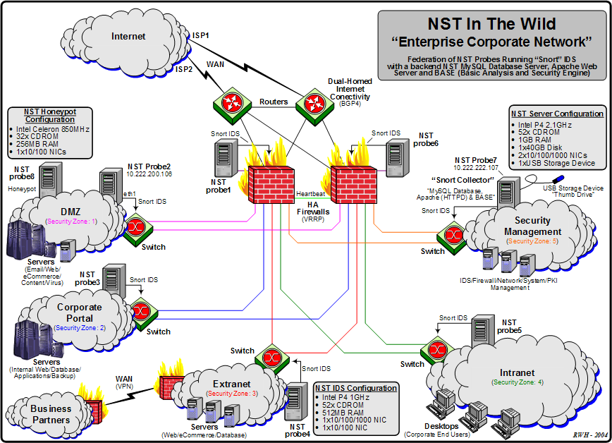
Maybe this is the problem?
Notes:
(i). Every device is different; no common way of thinking about the data plane
(ii). Myopic view (box view vs network view)
(iii). Configuration and policy deeply intertwined → network is database of record and the like

Slide 12
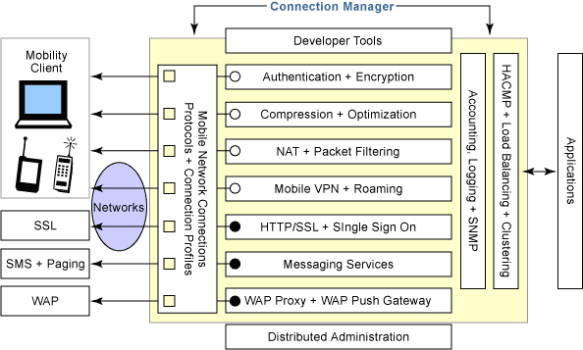
Or This?
Many protocols, many touch points, few open interfaces or abstractions,..
Network is Robust *and* Fragile

Slide 13
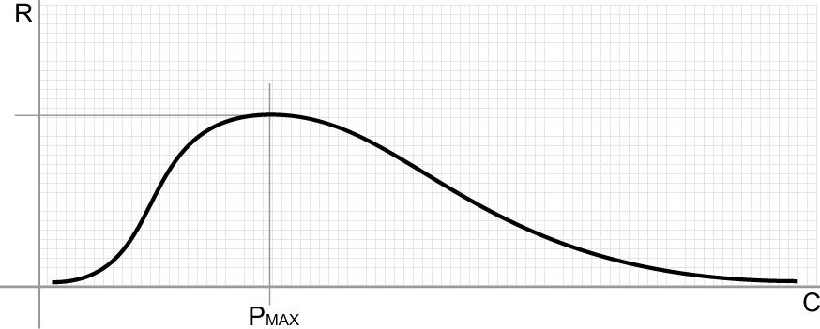
Robustness vs. Complexity
Systems View
Domain of the Robust
Domain of the Fragile
Increasing number of policies, protocols, configurations and interactions (well, and code)
Can we characterize the Robust and the Fragile?

Slide 14
So what are Robustness and Fragility?
Definition: A [property] of a [system] is robust if it is [invariant] with respect to a [set of perturbations], up to some limit
  Robustness is the preservation of a certain property in the presence of uncertainty in components or the environment
Fragility is the opposite of robustness
  If you're fragile you depend on 2nd order effects (acceleration) and the “harm” curve is concave
  A little more on this later…
A system can have a property that is robust to one set of perturbations and yet fragile for a different property and/or perturbation → the system is Robust Yet Fragile (RYF-complex)
  Or the system may collapse if it experiences perturbations above a certain threshold (K-fragile)
Example: A possible RYF tradeoff is that a system with high efficiency (i.e., using minimal system resources) might be unreliable (i.e., fragile to component failure) or hard to evolve
  Example: VRRP provides robustness to failure of a router/interface, but introduces fragilities in the protocol/implementation
  Complexity/Robustness Spirals
Conjecture: The RYF tradeoff is a hard limit and RYF behavior is “conserved”
See Alderson, D. and J. Doyle, “Contrasting Views of Complexity and Their Implications For Network-Centric Infrastructures”, IEEE TRANSACTIONS ON SYSTEMS, MAN, AND CYBERNETICS—PART A: SYSTEMS AND HUMANS,
VOL. 40, NO. 4, JULY 2010

Slide 15
Robust
RYF Examples
Yet Fragile
Efficient, flexible metabolism
Complex development and
Immune systems
Regeneration & renewal
Complex societies
Advanced technologies
Obesity and diabetes
Rich microbe ecosystem
Inflammation, Auto-Im.
Cancer
Epidemics, war, …
Catastrophic failures
“Evolved” mechanisms for robustness allow for, even facilitate, novel, severe fragilities elsewhere
Often involving hijacking/exploiting the same mechanism
  We’ve certainly seen this in the Internet space
  Consider DDOS of various varieties
There are hard constraints (i.e., theorems with proofs)

Slide 16
System features cast as Robustness
Scalability is robustness to changes to the size and complexity of a system as a whole
Evolvability is robustness of lineages to changes on long time scales
Other system features cast as robustness
  Reliability is robustness to component failures
  Efficiency is robustness to resource scarcity
  Modularity is robustness to component rearrangements
In our case: holds for protocols, systems, and operations

Slide 17
Brief Aside: Fragility and Scaling
(geeking out for a sec…)
A bit of a formal description of fragility
  Let z be some stress level, p some property, and
  Let H(p,z) be the (negative valued) harm function
  Then for the fragile the following must hold
    H(p,nz) < nH(p,z) for 0 < nz < K
For example, a coffee cup on a table suffers non-linearly more from large deviations (H(p, nz)) than from the cumulative effect of smaller events (nH(p,z))
  So the cup is damaged far more by tail events than those within a few σ of the mean
  Too theoretical? Perhaps, but consider: ARP storms, micro-loops, congestion collapse, AS 7007, …
  BTW, nature requires this property
    Consider: jump off something 1 foot high 30 times v/s jumping off something 30 feet high once
When we say something scales like O(n²), what we mean is the damage to the network has constant acceleration (2) for weird enough n (e.g., outside say, 10 σ)
  Again, ARP storms, congestion collapse, AS 7007, DDOS, … → non-linear damage

Slide 18
What Is Antifragility?
Antifragility is not the opposite of fragility
  Robustness is the opposite of fragility
  Antifragile systems improve as a result of [perturbation]
Metaphors
  Fragile: Sword of Damocles
    Upper bound: No damage
    Lower bound: Completely destroyed
  Robust: Phoenix
    Upper bound == lower bound == no damage
  Antifragile: Hydra
    Lower bound: Robust
    Upper bound: Becomes better as a result of perturbations (within bounds)
More detail on this later (if we have time)
  But see Jim’s blog
  http://www.renesys.com/blog/2013/05/syrian-internet-fragility.shtml

Slide 19
Aside: What is Complexity?
“In our view, however, complexity is most succinctly discussed in terms of functionality and its robustness. Specifically, we argue that complexity in highly organized systems arises primarily from design strategies intended to create robustness to uncertainty in their environments and component parts.”
See Alderson, D. and J. Doyle, “Contrasting Views of Complexity and Their Implications For Network-Centric Infrastructures”,
IEEE TRANSACTIONS ON SYSTEMS, MAN, AND CYBERNETICS—PART A: SYSTEMS AND HUMANS, VOL. 40, NO. 4, JULY 2010

Slide 20
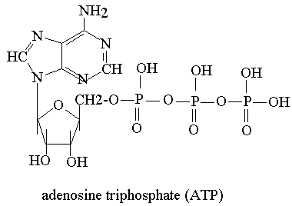
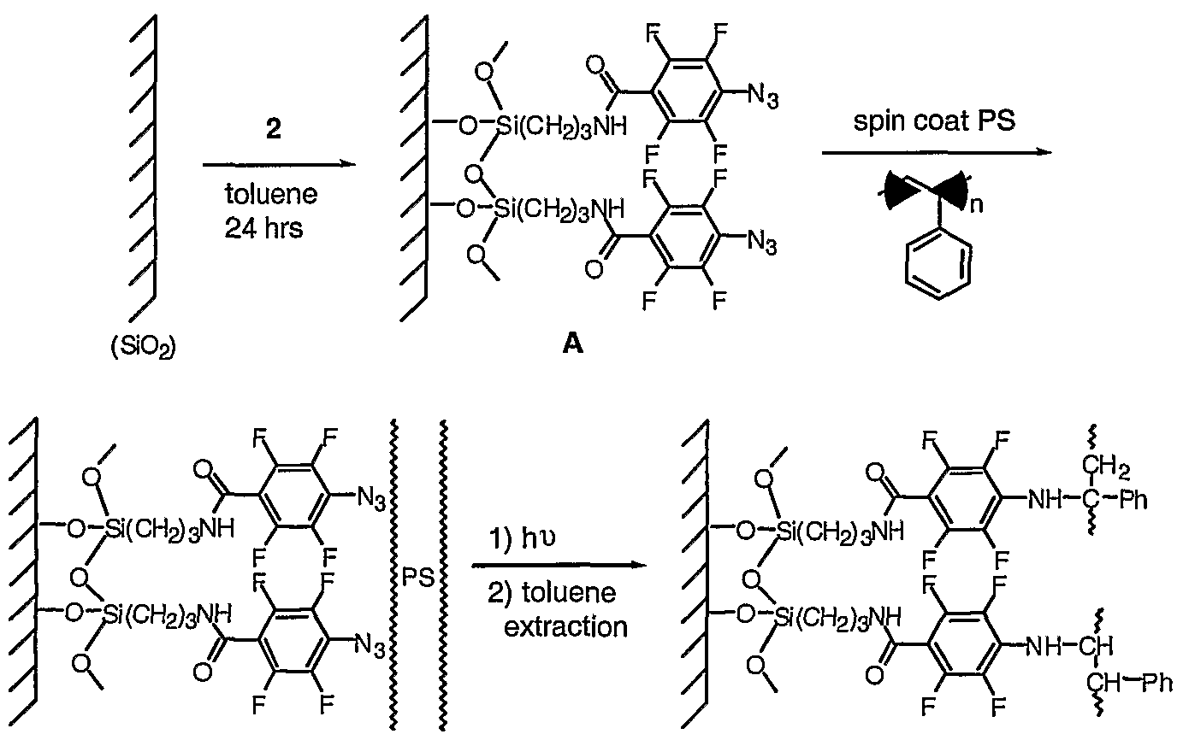
Aside: Biology and Technology
Look the Same?
Silicon Wafer Substrate
Molecular Level View

Slide 21
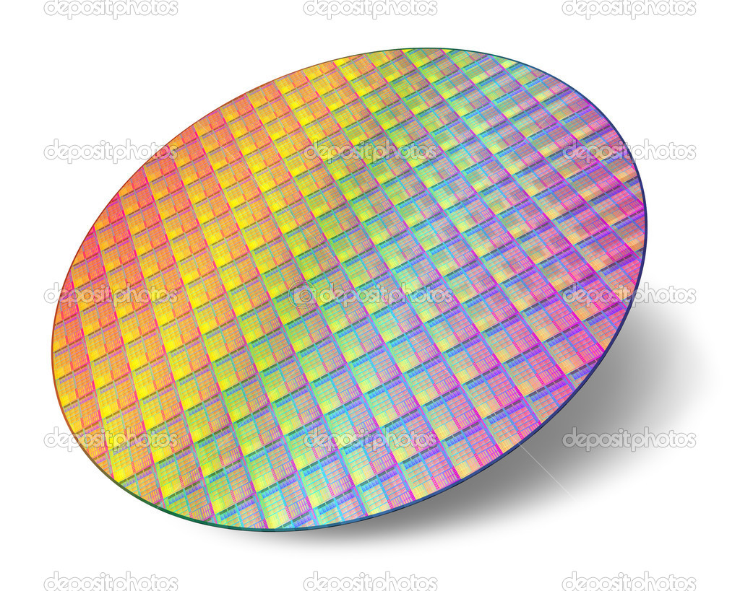
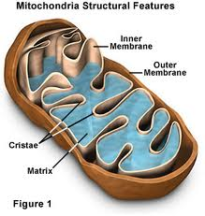
Moving up in Organization…
How about these?
Component Level View

Slide 22
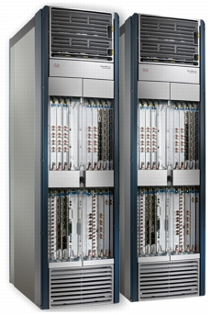
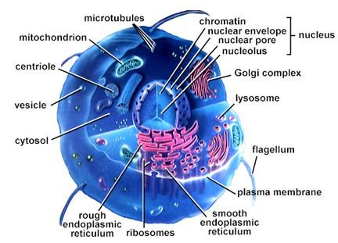
How About These?
“Integrated” Component Level View
(note: multi-scale resolution)

Slide 23
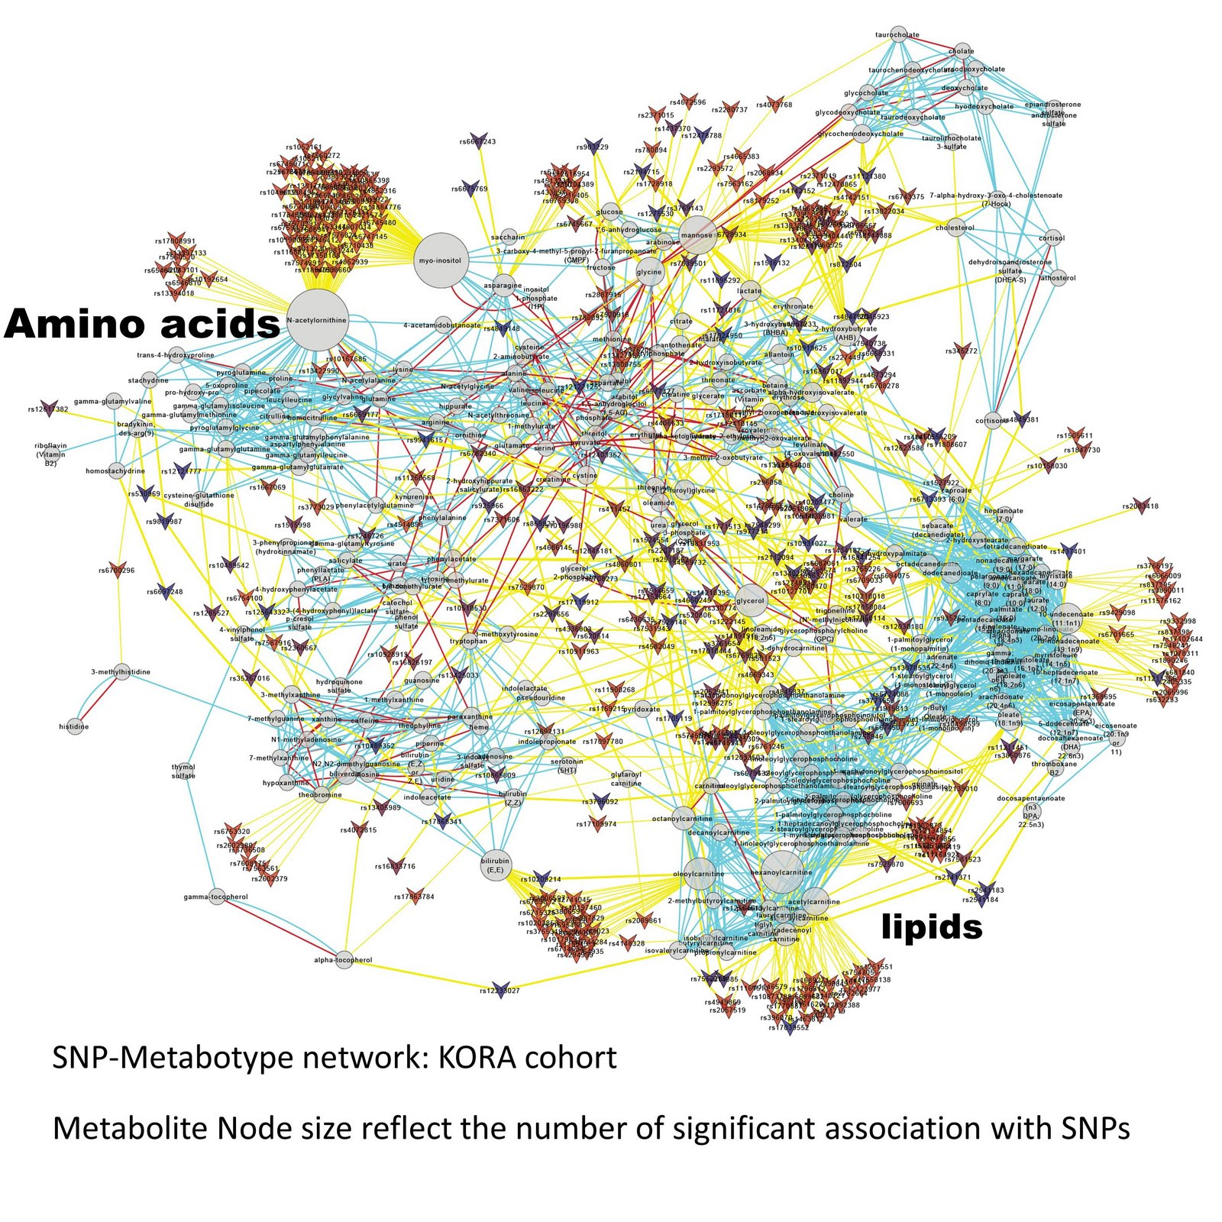
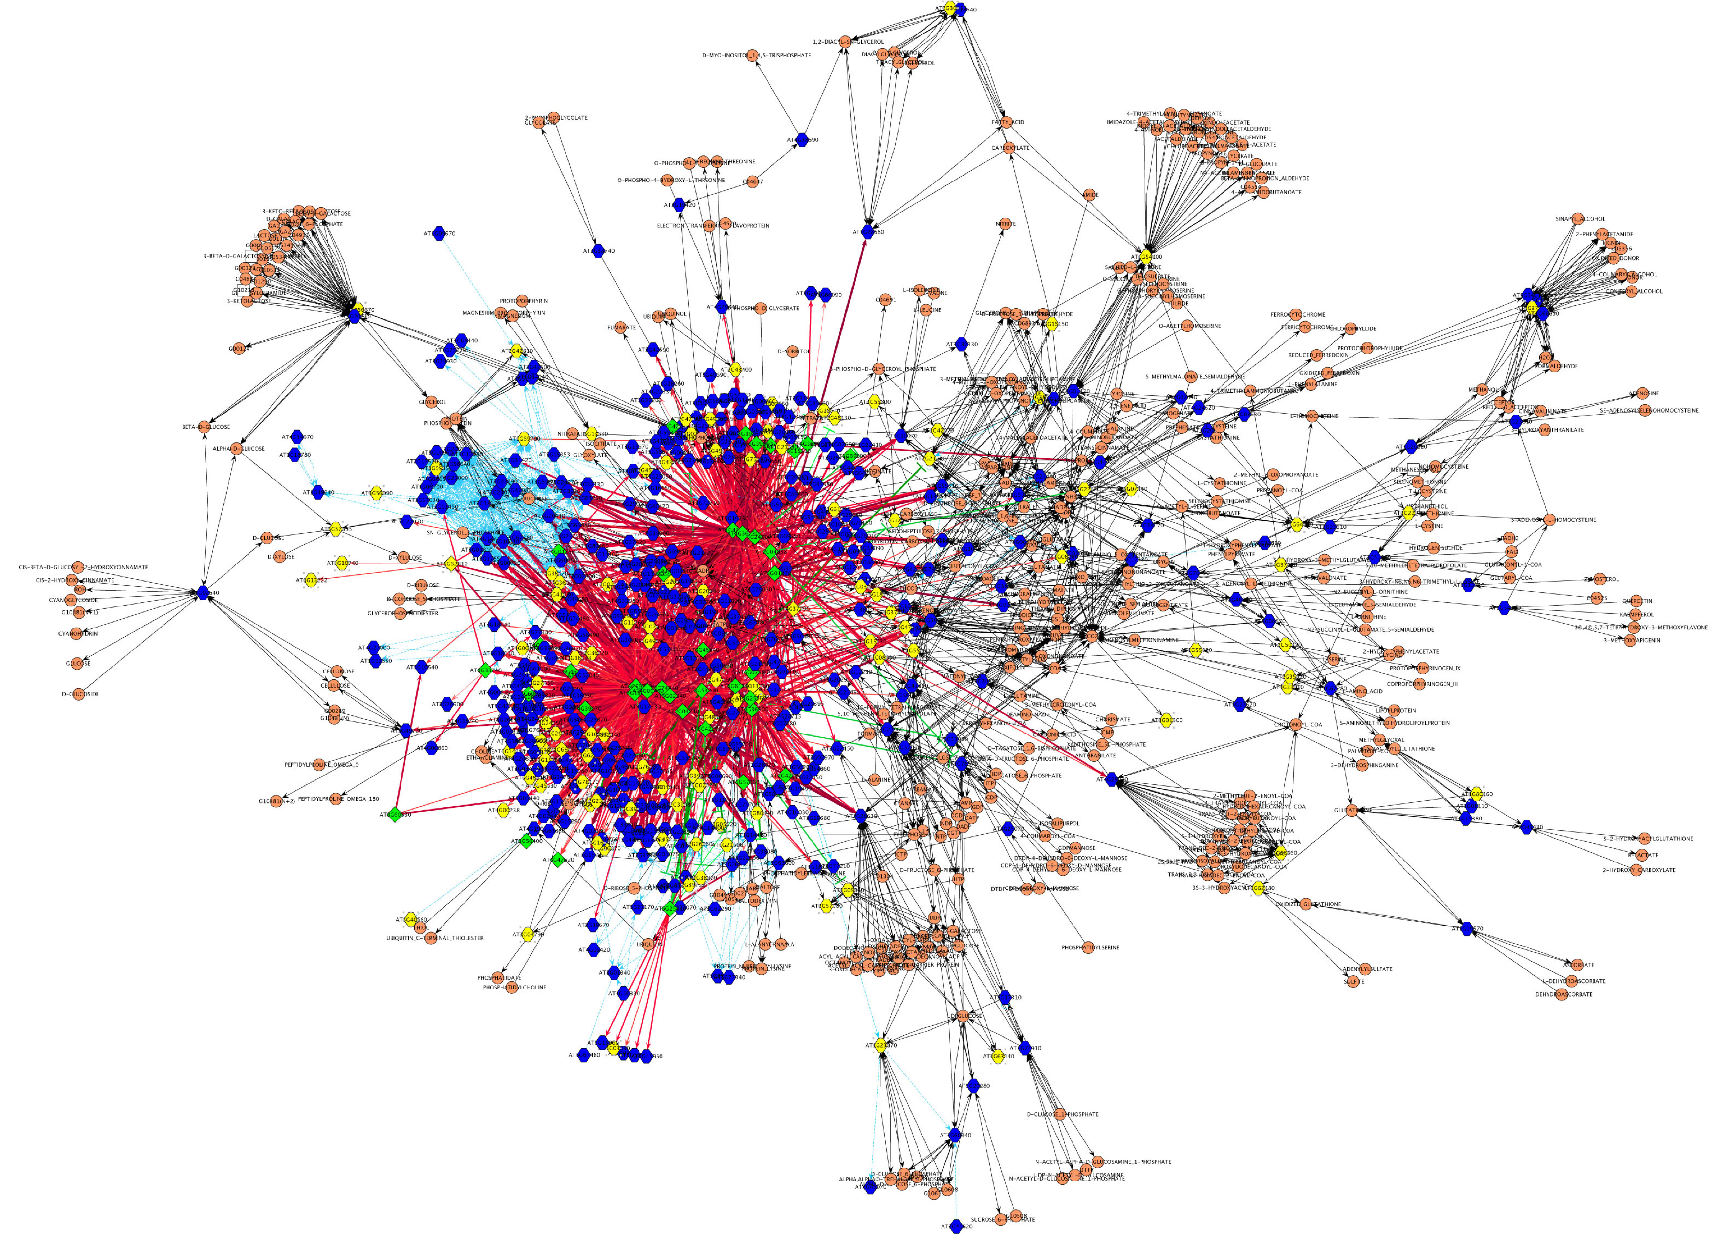
But When You Get to Higher Levels of Organization….
At the molecular and component levels, biological and advanced technological systems
are very different. At higher levels of organization, they start to look remarkably similar
and share universal properties that confer scalability and evolvablity.

Slide 24
BTW, This Might Also Obvious But…
Networks are incredibly general and expressive structures
  G = (V,E)
Networks are extremely common in nature
  Immune systems, energy metabolism, transportation systems, health care systems, Internet, macro economies, forest ecology, the main sequence (stellar evolution), galactic structures, ….
  Convergent Evolution observed in both Biology and Engineering
So it comes as no surprise that we study, for example, biological systems in our attempts to get a deeper understanding of complexity and the architectures that provide for scalability, evolvability, and the like
Ok, this is cool, but what are the key architectural takeaways from this work for us ?
  where us \in {ops, engineering, architects …}
  And how might this effect the way we build and operate networks?
  Keep this question in mind…

Slide 25
Ok, Key Architectural Takeaways?
What we have learned is that there are fundamental architectural building blocks found in systems that scale and are evolvable. These include
  RYF complexity
  Bowtie architectures
  Massively distributed with robust control loops
    Contrast optimal control loops and hop-by-hop control
  Highly layered
    But with layer violations, e.g., Internet, overlay virtualization
  Protocol Based Architectures (PBAs)
  Degeneracy

Slide 26
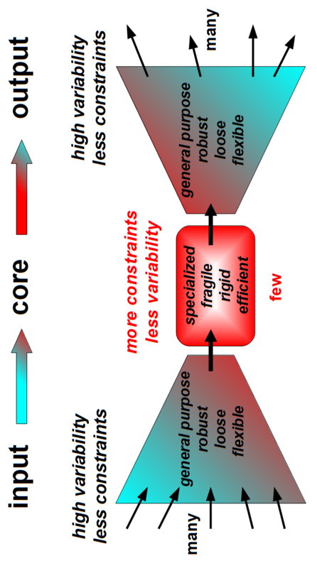
Bowties 101
Constraints that Deconstrain
For example, the reactions and metabolites of core
metabolism, e.g., ATP metabolism, Krebs/Citric Acid
cycle signaling networks, …
See Kirschner M., and Gerhart J., “Evolvability”, Proc Natl Acad Sci USA , 95:8420–8427, 1998.

Slide 27
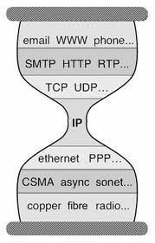
But Wait a Second
Anything Look Familiar?
Bowtie Architecture
Hourglass Architecture
The Protocol Hourglass idea appears to have originated with Steve Deering. See Deering, S., “Watching the Waist of the Protocol Hourglass”, IETF 51,
2001, http://www.iab.org/wp-content/IAB-uploads/2011/03/hourglass-london-ietf.pdf. See also Akhshabi, S. and C. Dovrolis, “The Evolution of Layered
Protocol Stacks Leads to an Hourglass-Shaped Architecture”, http://conferences.sigcomm.org/sigcomm/2011/papers/sigcomm/p206.pdf.

Slide 28
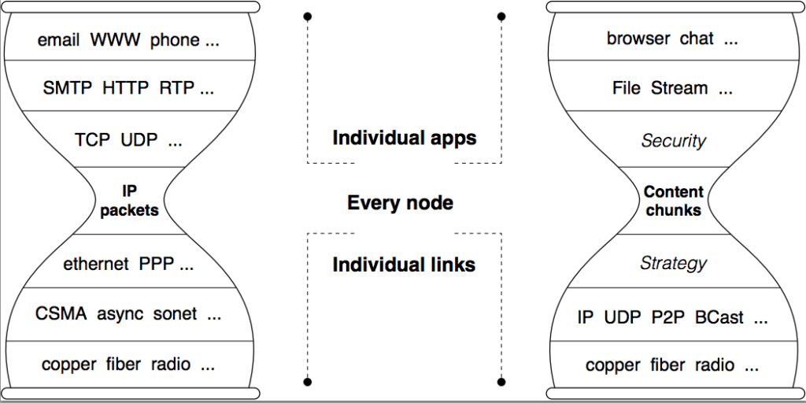
NDN Hourglass
See Named Data Networking, http://named-data.net/

Slide 29
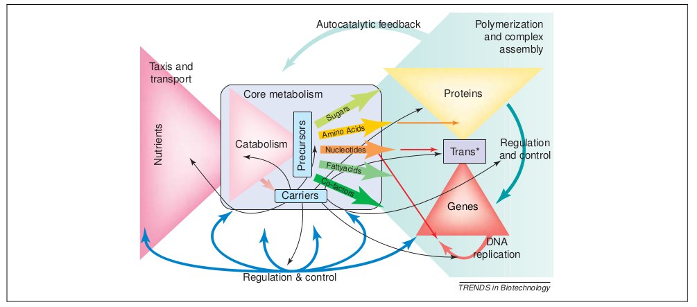
In Practice Things are More Complicated
The Nested Bowtie Architecture of Metabolism
See Csete, M. and J. Doyle, “Bow ties, metabolism and disease”, TRENDS in Biotechnology, Vol. 22 No. 9, Sept 2004

Slide 30
Biology versus the Internet
Similarities
Evolvable architecture
Robust yet fragile
Layering, modularity
Hourglass with bowties
Dynamics
Feedback
Distributed/decentralized
Not scale-free, edge-of-chaos, self-organized criticality, etc
Differences
Metabolism
Materials and energy
Autocatalytic feedback
Feedback complexity
Development and regeneration
>3B years of evolution
An Autocatalytic Reaction is one in which
at least one of the reactants is also a product.
The rate equations for autocatalytic reactions
are fundamentally non-linear.

Slide 31
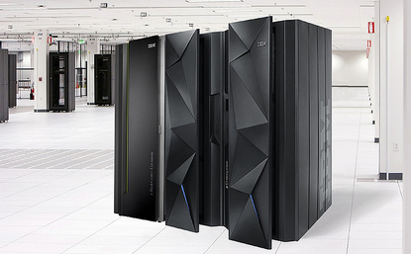
Ok, Back to SDN
How Did We Get Here?
Basically, everything networking was too vertically integrated, tightly coupled, non-standard.
Goes without saying that this made the job of the network researcher almost impossible.
Question: What is the relationship between the job of the network researcher and
the task of fielding of a production network?

Slide 32






















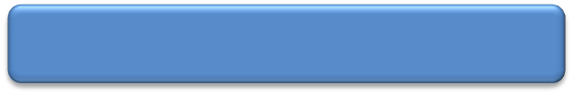
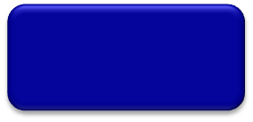
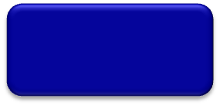
So Let’s Have a Look at OF/SDN
Here’s Another View of the Thesis
App
App
App
App
App
App
Controller 1
Controller
2
Windows
(OS)
Linux
Mac
OS
Controller 1
Controller
2
Windows
(OS)
Linux
Mac
OS
NOX
(Network OS)
Network OS
Windows
(OS)
Linux
Mac
OS
Is this a good analogy?
Virtualization layer
Virtualization or “Slicing”
x86
(Computer)
OpenFlow
Computer Industry
Network Industry
Separation of Control and Data Planes
Open Interface to Data Plane
Centralized Control (logically?)
Graphic Courtesy Rob Sherwood
Notes:
32

Slide 33
A Closer Look
App
App
“NB API”
App
App
App
OpenFlow Controller
Control plane
Data plane
OpenFlow Protocol
Simple Packet Forwarding Hardware
Simple Packet Forwarding Hardware
Simple Packet Forwarding Hardware
Simple Packet Forwarding Hardware
Simple Packet Forwarding Hardware
Graphic courtesy Nick Mckeown
33
Notes:
Switches, routers and other middleboxes are dumbed down
The key is to have a standardized control interface that speaks directly to hardware

Slide 34
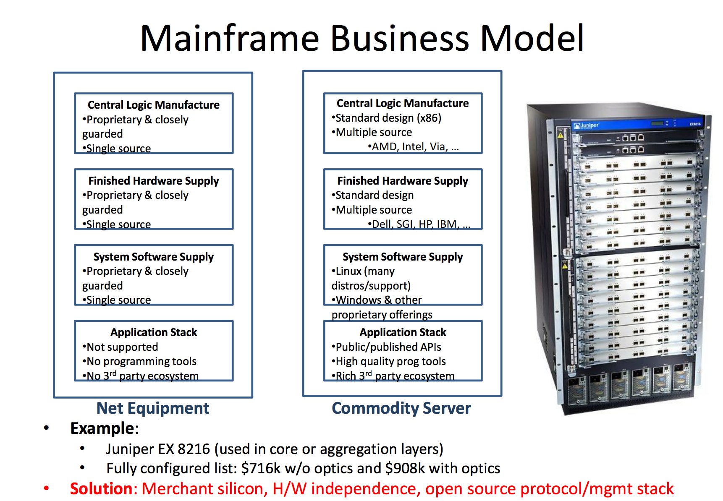
So Does the OF/SDN-Compute Analogy Hold?
Really Doesn’t Look Like It
A better analogy would be an open source network stack/OS on white-box hardware
Graphic courtesy James Hamilton, http://mvdirona.com/jrh/TalksAndPapers/JamesHamilton_POA20101026_External.pdf.

Slide 35
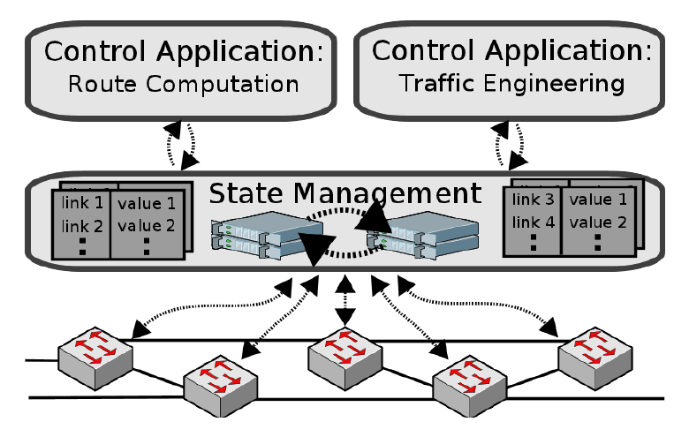
BTW, Logically Centralized?
Key Observation: Logically centralized → distributed system → tradeoffs between
control plane convergence and state consistency model. See the CAP Theorem.
Architectural Implication: If you break CP/DP fate sharing you have to deal the following
physics: Ω(convergence) = Σ RTT(controller, switch_{i}) + PPT(i,controller) + PPT(switch_{i})
Graphic courtesy Dan Levin <dlevin@net.t-labs.tu-berlin.de>

Slide 36
BTW, Nothing New Under The Sun…
Separation of control and data planes and centralized control are not a new ideas. Examples include:
  SS7
  Ipsilon Flow Switching
    Centralized flow based control, ATM link layer
    GSMP (RFC 3292)
  AT&T SDN
    Centralized control and provisioning of SDH/TDM networks
  TDM voice to VOIP transition
    Softswitch → Controller
    Media gateway → Switch
    H.248 → Device interface
    Note 2nd order effect: This was really about circuit → packet
  ForCES
    Separation of control and data planes
    RFC 3746 (and many others)
  …

Slide 37
Drilling Down: What is OpenFlow 1.0?
Redirect to Controller
Encapsulate packet to controller
Flow Table
(TCAM)
Apply actions
Packet
Forward with
edits
Switch Model (Match-Action Tables)
Binary wire protocol
Transport (TCP, SSL, …)
Too simple:
Feature/functionality
Expressiveness – consider shared table learning/forwarding bridge
Drop

Slide 38
OK, Fast Forward to Today: OF 1.1+
Why this design?
  Combinatoric explosion(s) s/a routes*policies in single table
However, intractable complexity: O(n!) paths through tables of a single switch
  c ≈ a^{(2^l)} + α
  where a = number of actions in a given table, l = width of match field, and
  α all the factors I didn’t consider (e.g., table size, function, group tables, meter tables, …)
Too complex/brittle
  Algorithmic complexity
  What is a flow?
  Not naturally implementable on ASIC h/w
  Breaks new reasoning systems/network compilers
  No fixes for lossy abstractions (loss/leakage)
  Architectural questions
So question: Is the flow-based
abstraction “right” for general
network programmability?
See “Forwarding Metamorphosis: Fast Programmable Match-Action Processing in Hardware for SDN”
http://conferences.sigcomm.org/sigcomm/2013/papers/sigcomm/p99.pdf for an alternate perspective.

Slide 39
A Perhaps Controversial View on SDN
OF/SDN is a point in a larger design space
  But not the only one
The larger space includes
  Control plane programmability
  Overlays
  Compute, Storage, and Network Programmability
  View SDN, NfV, … as optimizations
My model: “SDN continuum”

Slide 40
NfV and SDN as Optimizations
F
F
Cut-Through (SDN)
In-Line (NfV)
F
Slide courtesy Larry Peterson, SIGCOM 2013
Notes:
Start – Models an App.
Cut-Through – Behaves like a Controller
In-Line – Behaves like NFV

Slide 41
A Simplified View of the SDN Continuum
Service Layers
Apps
Apps
May be repeated
(stacked or recursive)
…
Control and Orchestration
(overly simplified view)
FP/SDN
Properties:
-- Complete Separation of CP and FP
-- Centralized Control
-- Open Interface/programmable Forwarding Plane
-- Examples: OF, ForCES, various control platforms
CP/SDN
Properties:
-- Retains existing (distributed) Control Planes
-- Programmable control plane
-- Examples: PCE, I2RS,BGP-LS, vendor SDKs
OL/SDN
Properties:
-- Retains existing (simplified) Control Planes
-- Programmable overlay control plane
-- Examples: Various Overlay technologies
Physical and Virtual Resources
(CSNSE)
Notes:
OF/SDN is a polar architectural design point; complete separation of control and data planes
CP/SDN is adds programmability in an incremental way to conventional control planes; some targeted separation (e.g., PCE)/centralization
OL/SDN (Overlay/SDN) retains the control plane architecture of CP/SDN but adds a new, logically centralized control plane (“over” CP/SDN)

Slide 42
Bowties/Hourglasses?
Open Loop Control + s/w + Moore’s Law → Randomness, Uncertainty, and Volatility
OL/SDN
CP/SDN
OF/SDN?
OF/SDN?
CP/SDN makes existing control planes programmable
OL/SDN is an application from the perspective of the Internet’s waist

Slide 43

So The Future: Where’s it All Going?

Slide 44
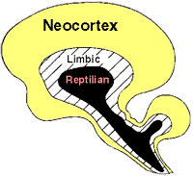
But More Seriously….
High order bit:
  System(s) we’re building are inherently uncertain → cloudy crystal balls
  Architect for change and rapid evolution – see XP/Agile methodologies for a clue
  Increasing roles for s/w and programmability + Moore’s law → volatility/uncertainty
  Lucky thing for many of us: we work primarily around the narrow waist, most stable place to be
  “Above the waist” characterized by uncertainty, e.g., http://spotcloud.com/
Conventional Technology Curves – S & F
  Moore’s Law and the reptilian brain
    Someone eventually has to forward packets on the wire
  400G and 1T in the “near” term
  Silicon photonics, denser core count, ….
The future is all about Ecosystems
  Open Interfaces: Protocols, APIs, Code, Tool Chains
  Open Control Platforms at every level
  “Best of Breed” markets
  And again, more volatility/uncertainty injected into system as a whole
Open *everything*

Slide 45
Summary – What are our Options
  Be conservative with the narrow waist -- constraints that deconstrain
  We’re pretty good at this
  Reuse parts where possible (we’re also pretty good at this; traceroute a canonical example)
Expect uncertainty and volatility from above
  Inherent in software, and importantly, in acceleration
    We know the network is RYF-complex so we know that for H(p,x), the “harm” function, d²H(p,x)/dx² ≠ 0
    When you architect for robustness, understand what fragilities have been created
  → Software (SDN or http://spotcloud.com or …) is inherently non-linear, volatility, and uncertain
    We need to learn to live with/benefit from the non-linear, random, uncertain
DevOps
Develop our understanding bottom up (by “tinkering”)
  Actually an “Internet principle”. We learn incrementally…
  Avoid the top-down (in epistemology, science, engineering,…)
  Bottom-up v. top-down innovation cycles – cf Curtis Carlson
Design future software ecosystems to benefit from variability and uncertainty rather than trying to engineer it out (as shielding these systems from the random may actually cause harm)
  For example, design in degeneracy -- i.e., “ability of structurally different elements of a system to perform the same function”. In other words, design in partial functional overlap of elements capable of non-rigid, flexible and versatile functionality. This allows for evolution *plus* redundancy. Contrast m:n redundancy (i.e., we do just the opposite).

Slide 46
Q&A
Thanks!

