Slide 1
Virtualising The Network with Cloud-based CPE
Tim Nagy
AusNOG 2013 – 6 September 2013

Slide 2
CHALLENGES WITH TODAY’S FIXED SERVICE ARCHITECTURE
Today’s Fixed Service Architecture
is heavily dependent upon high-function CPE devices
that present challenges to the Service Provider Business Model
Stalled Service Innovation
  A Site / Location / Line = A Customer
  No visibility of end devices, user sessions & state
  High touch upgrades impede new service rollout
  Proliferation of OTT substitutes = “the invisible cloud”
Slow Service Innovation
Increasing Churn
Service Revenue
New Services = additional CPE functionality
  CPE is low margin resale
  Higher function, or more CPE increases CAPEX
  Increased complexity of CPE increases OPEX
  Complexity increases probability of poor user experience
Increasing OPEX
Increasing CAPEX
Service Margin

Slide 3
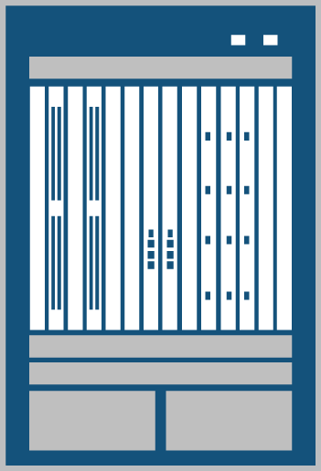




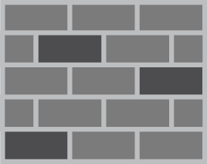
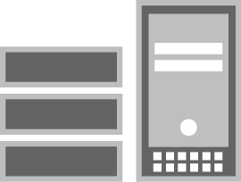













The concept of Cloud-Based CPE
  Simplify the device required on the customer premise
  Centralize key CPE functions & integrate them into the network edge
BNG / PE in SP Network
Typical CPE Functions
Simplified L2 CPE
Routing / IP Forwarding
Firewall
DHCP
Routing / IP Forwarding
FW
NAT
MoCA/ HPAV/ HPNA3
Voice
Access Point
Switch
Modem / ONT
DHCP
NAT
MoCA/ HPAV/ HPNA3
Voice
Access Point
Switch
Modem / ONT
Direct Connect
  Extend reach & visibility into the home
  Per device awareness & state
  Simplified user experience
A Simplified CPE
  Remove CPE barriers to service innovation
  Lower complexity & cost
In Network CPE functions
  Leverage & integrate with other network services
  Centralize & consolidate
  Seamlessly integrate with mobile & cloud based services

Slide 4
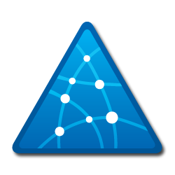
COMPARING TODAY’S CPE WITH CLOUD CPE
Physical CPE
Cloud CPE
Functionality Rich
Feature Oriented
Service Oriented
Localized
Abstracted
Demarcation Wall
Site & Device Visibility
Hardcoded Capability
Extensible Capability
Static Capacity
Elastic Resources
High Touch Operations
Internalized Management
Linear Costs
Marginal Costs
Single Management Touch point

Slide 5
Business Services – Potential Applications
Business Services | Machine to machine applications
 | Building Automation
Business Applications | Unified Communications as a Services
 | Productivity & Storage – Software as a Service
VPN Light | Secure access for remote users
 | Cost effective VPN services for Branches & Retail sites
Secure Business Internet | Clean Pipes
 | Managed Firewall

Slide 6








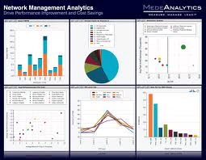

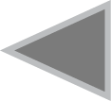

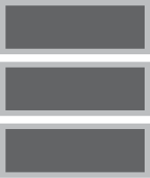



Vision for Cloud-based CPE
End-to-end solution for moving services and value into the cloud
Today
Full featured CPE
HQ DC
Service Provider
IP Edge
Internet
Data Center
FW & UTM
DHCP
NAT
Routing
Modem / ONT
Switch
Wireless
Controller
Voice
Management
Cloud-CPE solution
VPN
CGNAT
Routing
DHCP
“Cloud-Connect” CPE
Wireless
Controller
Storage
Premises
Security + Automation
FW & UTM
Modem / ONT
Switch
Access Point
Voice
Service Provider CO/PoP/DC
or
Enterprise HQ/DC
User/Role
Awareness
Deep Inspection/ Monitoring
Business
Apps
Management
Notes:
Today’s Fixed Service Architecture is heavily dependent upon high function CPE devices that also present challenges to the Service Provider Business Model. With this CPE centric model service innovation often requires additional that functionality be added to the CPE directly increasing its cost and complexity. Furthermore, functions such as NAT in the CPE prevent Service Provider visibility to the number and type of attached devices in the home – in essence a subscriber is equal to an entire household. Conversely in the mobile service architecture, where service creativity and velocity are evident, each device is directly attached and completely visible to the Service Provider network. Because of its lack of visibility & control service innovation is stalled from a creativity standpoint and the requirements to introduce new features and functions into millions of deployed CPE devices significantly impacts service velocity, not to mention the increased CAPEX and OPEX costs associated with acquiring higher function CPE devices, CPE replacements and sw upgrades and increase cost of managing millions of complex devices in homes and small businesses.
Juniper can disrupt the BB CPE market with a simplified architecture – by moving key CPE functions into the cloud integrating them into the network & monetize as SW and as a result simplify the device in the home to provide nothing more than connectivity. This simplifies & improves the user experience, and improves the economics of networking by removing CPE service innovation barriers, provided visibility to all attached devices, and leveraging & integrating with other network services.

Slide 7

CLOUD CPE ARCHITECTURE
HIGH LEVEL COMPONENTS
  Provisioning
  Monitoring
  Customer Self-care
Management
Onsite CPE
  CPE specific context in router
  Layer 3 services (addressing & routing)
  Basic value services (NAT, Firewall,…)
Customer Site
Access & Aggregation
vCPE Context
Simplified CPE device with switching, access point, upstream QoS and WAN interfaces
Optional L3 and Tunneling
Services
Edge Router
  Advanced security services (UTM, IPS, Firewall,…)
  Extensible to other value added services (M2M, WLAN, Hosting, Business apps,…)
  Cloud based
Notes:
7
With this new service architecture it becomes simple to blend in home and in cloud services to offer unique & innovative consumer services. For example Universal Plug and Play (UPnP) is used in the home to support zero-configuration, "invisible" networking, and automatic discovery for a breadth of device categories from a wide range of vendors. This means a device can dynamically join a network, obtain an IP address, convey its capabilities, and learn about the presence and capabilities of other devices.
By implementing the My Home VPN service the this same construct can be used to enable new services that are cloud based. A service provider could implement a portal where consumers could subscribe to services offered in the cloud. Once subscribed to, the service is connected to the My Home VPN and using UPnP devices connected in the home can dynamically discover, access and consume the cloud based services as if they were deployed and available directly in the home.

Slide 8





CLOUD CPE FOR BROADBAND SUBSCRIBERS
“NETWORK ENRICHED RESIDENTIAL GATEWAY” (BBF)
Enhanced Visibility, Control & Service Innovation at a Fraction of Costs for Existing L3 CPE Service Architecture
Management & Self-care
Mobile/Remote VPN Members
Cloud CPE
Layer 2 CPE
Routing (IP Forwarding), SFW NAT, DHCP Server/Relay, UPnP Proxy/Relay
Dynamic Service Activation via RADIUS / DHCP interaction
Dynamic VLAN Assignment
Dynamic Policy & Profiles; QoS, Accounting, Traffic Mgmt
Captive Portal Redirection
My Home VPN services
Tunnel Termination
TR69 Agent
Connectivity / Smart Switching
Wireless AP
Zero Touch Provision
802.1 p/q
Internet
C-CPE Context
SP Data Center
Wii
In Home Services ↔ My Home VPN ↔ SP Cloud Services
Private IP Address Domain
Public/Private IP Address Domain
Notes:
The cloud CPE solution architecture includes the Layer 2 CPE deployed in the home offering switched connectivity between devices and access to the cloud and Internet via a WAN connection to the service provider access network. DHCP services, NAT and IP Forwarding are provided by the Cloud CPE context on the MX platform. There is one Cloud CPE context per household. The cloud CPE context can also be incorporated with Junos VPN services to create the My home VPN which can be used to create a unique blend of in home and in cloud services. These services can be consumed from within the home of from any Internet enabled connection with secure access from a Junos Pulse enabled device. This disruptive service architecture provides a flexible platform offering enhanced visibility, control and innovation at a faction of the cost of today’s CPE centric architecture.

Slide 9

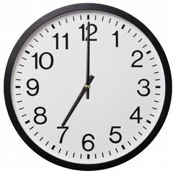



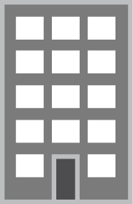
BROADBAND DEVICE VISIBILITY
EXAMPLE: PARENTAL CONTROL BASED ON DEVICE POLICIES
TIME OF DAY
CONTENT FILTER
Internet access from this device is not permitted between 7pm and 7am.
Try again tomorrow
You have tried to access www.iwishiwere21.com
This site is filtered in order to protect you
Little Jimmy’s Desktop
L2 Bridge
ACTIVITY REPORTING
Laptop
Volumes
Content
Twitter.com
Tablet
Facebook.com
Hulu.com
Wikipedia.com
Iwishiwere21.com
HOME NETWORK
Portal / Mobile App
Self-care & Reporting
Notes:
9

Slide 10



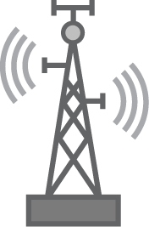

BUSINESS CLOUD CPE
CO/POP Centric Architecture (PE)
Residence,
Home
DSL or PON, Cable
Wireless L2 Bridge
SOHO, SMB, Branch
DSL or PON, Cable
Mega PoP / Data-Center
CO / PoP
Wireless L2 Bridge
PE Router
DSL or PON, Cable
TDM, Ethernet
Cloud CPE Context
vIdentity Server
Management
SMB, Branch
Cloud-Connect or Router
Routing
NAT
Service-
Eng’d Paths
(SEP)
VPN
DHCP
Service Complex/VA
Enterprise
TDM, Ethernet
SEP
Data-Center Edge Router
Identity GW
Cloud-Connect or Router
Service Complex/ VA
…
…
4G SMB,
Branch
Cell
Sites
Mobile
Backhaul
Mobile Terminals
Service Complex optionally placed locally
or in centralized/regional Data-Center or Mega-PoP

Slide 11

BUSINESS CLOUD CPE
DATA CENTER Centric Architecture (PE)
End-Customer Solutions
Cloud Branch Router
Cloud Security, etc…
Enterprise or SP Data Center
Tunnel Through VPN Service
SOHO, SMB, Branch
DSL or PON, Cable
Wireless L2 Bridge
DSL or PON, Cable
TDM, Ethernet
vIdentity Server
Management
SMB, Branch
SP 1
Cloud CPE Context
Wireless L2 Bridge
Internet
Routing
NAT
Service Complex / VA
SP N
VPN
Enterprise
TDM, Ethernet
DHCP
vIdentity GW
Router
Data-Center Edge Router
…
Cell
Sites
Mobile
Backhaul
Mobile Terminals

Slide 12
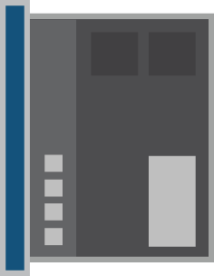

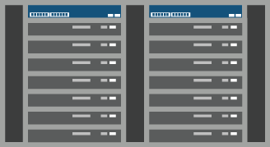
SERVICE COMPLEX OPTIONS & CONSIDERATIONS
Potential Models
Likely Deployment Location
Considerations
Service Card in Chassis
Large Central Office or Point of Presence
Likely integrated with BNG or PE router
Potentially as a Service Gateway or Aggregator
Scale bounded by available router slots
Simplified deployment & operations
Service location dictated by router placement
Longer technology life cycle
Virtual Appliance
Co-located with router platform in large CO or PoP
Centralized in Metro PoP or Data Center
Flexible deployment options
Simple to integrate new x86 technology
Scale incrementally
Multiple boxes - Potential operational issues & conflicts
Cloud Platform
Centralized in Cloud Data Center
On demand linear scale & multi-tenancy to scale instances)
Requires support of & integration with customer cloud platform
Potential operational conflicts
Potential of in-efficient traffic flow

Slide 13
FINAL THOUGHT - EXAMPLE OF BUSINESS CASE
REVENUE AND COST BENEFIT
3.45
  Outcome of business case for a service provider with 9M residential subscribers (DSL and fiber )
Revenue benefit, $ mn
Opex benefit, $ mn
482.0
92.8
  Rationale / Description
59.0
248.2
  Revenue benefit is driven primarily from reduced service churn in cloud CPE model and from new service (My Home VPN )
  Opex benefit comes from reduced volume of support calls related to CPE and service issues (partially offset by increased licensing fees)
  Capex benefit comes from reduced price of CPE equipment and less frequent CPE replacement
37.3
123.6
19.3
0.7
8.9
47.8
0.9
5.4
2012
13
14
15
16
2017
2012
13
14
15
16
2017
Capex benefit, $ mn
Margin benefit, % points
14.7
10.4
7.4
4.3
0.3
1.4
2012
13
14
15
16
2017
2012
13
14
15
16
2017

Slide 14
Thank you
Notes:
14

