Slide 1
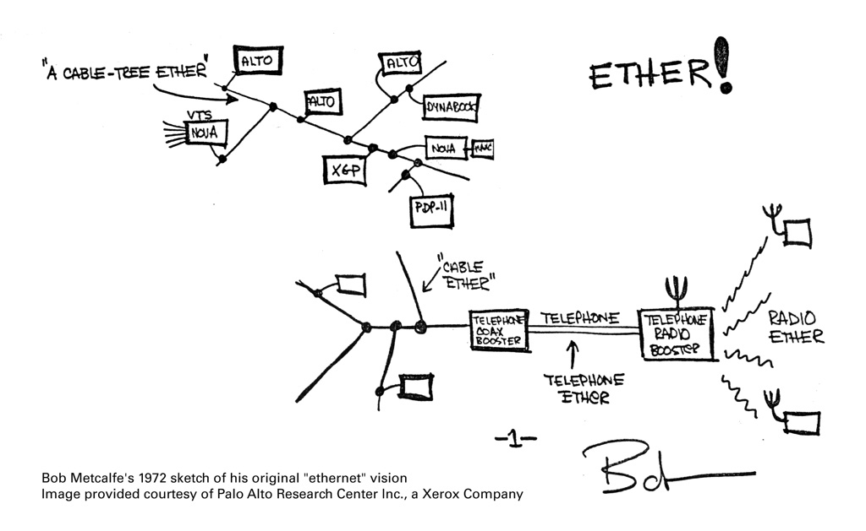
100 Gig E - What's New and
What's Next ?
“Here is more rough stuff on the ALTO ALOHA network.” Memo sent by
Bob Metcalfe on
May 22, 1973.
David White <david.white@brocade.com>
AUSNOG 2013
UKNOF25 2013/04/18

Slide 2
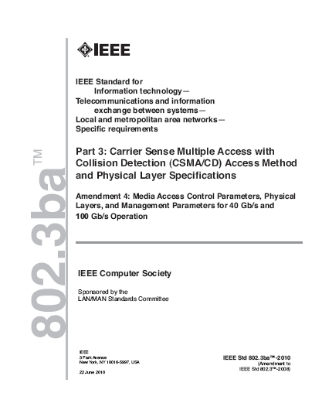
40 Gigabit and 100 Gigabit Ethernet Developments
IEEE 802.3ba standard approved June 17, 2010
  340 pages added to IEEE Std 802.3-2012
Shipping 1st generation media, test equipment, router interfaces, and optical transport gear in 2010/2011
Mature, interoperable technology with broad vendor support
2nd generation technology projects for both 40 and 100 GbE have started
  Expected on the market in 2013 – 2015+

Slide 3

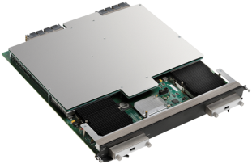
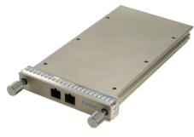

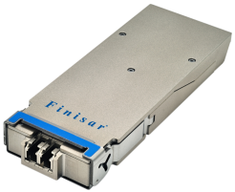
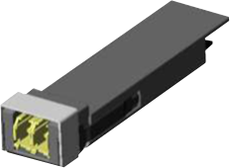
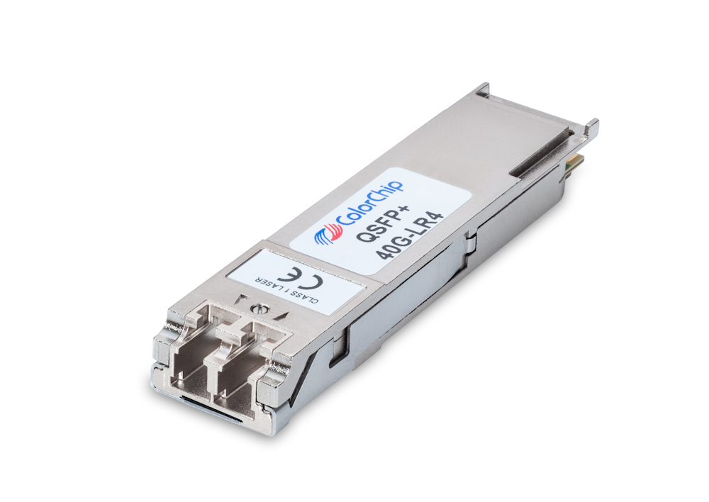
100 GbE Technology Adoption Timelines
CHASM
Innovators
Early Adopters
Early Majority
Late Majority
Laggards
2010/2011
1 - 2 Premium Ports/Slot
1st Generation (CFP)
2012
2 - 4 Premium Ports/Slot
Lower-Cost 1st Generation (CFP)
2013/2014
4 – 8 Lower-Cost Ports/Slot
2nd Generation (CFP2)
2015+
8 – 16 Commodity Ports/Slot
2nd Generation (CFP4, QSFP28)
2022+
24 – 48 Commodity Ports/Slot
3rd Generation (Serial 100 Gbps)
CFP images courtesy of Finisar.

Slide 4
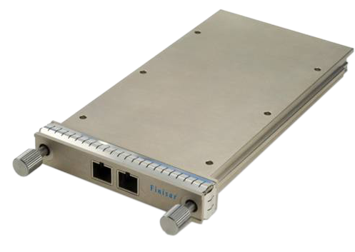
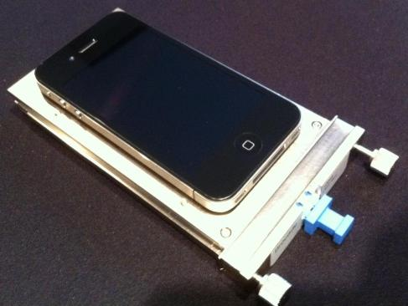
100 GbE CFP Modules
82 mm Wide
C (100) Form-factor Pluggable
145 mm Long
118 cm²
New module optimized for 100 GbE long reach applications
Used for 40GBASE-SR4, 40GBASE-LR4, 40GBASE-FR, 100GBASE-SR10, 100GBASE-LR4, 100GBASE-ER4, and 10x10 MSA
Complex electrical and optical components need a large module
Large module form factor and power consumption limits front panel density (larger than an iPhone 4)
14 mm High
CFP image courtesy of Finisar.

Slide 5




IEEE 802.3ba standards have a gap
  100GBASE-SR10 supports up to 150 m on OM4 MMF
  100GBASE-LR4 supports up to 10 km on SMF
  Missing a shorter SMF reach
100GBASE-LR4 100 GbE optics are complex and expensive
10x10 MSA bridges the gap
  Support for 2 km, 10 km and 40 km on SMF
  Considerably more economical
  Eliminates expensive components
  Consumes lesser power
Network operator members!
Members
www.10x10msa.org

Slide 6
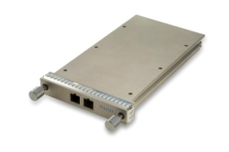
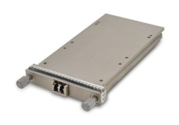
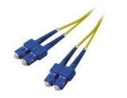

100 GbE Optics Overview
Physical Layer Reach | 100 m OM3/ 150 m OM4 MMF | 2 km SMF | 10 km SMF |  | 40 km SMF
CFP Module | 100GBASE-SR10 | 10x10-2km | 10x10-10km | 100GBASE-LR4 | 10x10-40km | 100GBASE-ER4
Media Type | Parallel MMF (MPO24) | Duplex SMF (LC) | Duplex SMF (LC) | Duplex SMF (SC) | Duplex SMF (LC) | Duplex SMF (LC)
Standard | June 2010 IEEE 802.3ba | March 2011 10x10 MSA | August 2011 10x10 MSA | June 2010 IEEE 802.3ba | August 2011 10x10 MSA | June 2010 IEEE 802.3ba
Electrical Signaling (Gbps) | 10 x 10 | 10 x 10 | 10 x 10 | 10 x 10 | 10 x 10 | 10 x 10
Optical Signaling (Gbps) | 10 x 10 | 10 x 10 | 10 x 10 | 4 x 25 | 10 x 10 | 4 x 25
Power (W) | 12 | 19 | 19 | 24 | TBD | 30
Availability | January 2013 | June 2011 | June 2011 | June 2011 | TBD | January 2013
Relative List Price | £ | £££ | ££££ | £££££ | TBD | £££££££££££££

Slide 7
Current State of the Industry
10
Electrical
Fundamental 1st generation technology constraints limit higher 100 GbE density and lower cost
Electrical signaling to the CFP
  100 Gbps Attachment Unit Interface (CAUI) uses 10 x 10 Gbps lanes
Optical signaling on the media
  10x10 MSA: 10 x 10 Gbps wavelengths
  100GBASE-LR4 and 100GBASE-ER4: 4 x 25 Gbps wavelengths
CFP module size and power consumption
82 mm Wide
145 mm Long
118 cm²
10
25
Optical
100 GbE
CFP image courtesy of Finisar.

Slide 8
1st Generation vs 2nd Generation 100 GbE
2nd Generation 100 GbE Needs Faster Electrical Signaling
1st Generation: 10 x 10 Gbps Electrical and 4 x 25 Gbps Optical 10 Gbps Electrical Signaling and 10:4 Gearbox Adds Complexity, Cost, Space, Power… | 2nd Generation: 4 x 25 Gbps 25 Gbps Electrical and Optical Signaling
Source: http://grouper.ieee.org/groups/802/3/ba/public/jul08/cole_03_0708.pdf

Slide 9
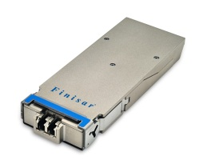

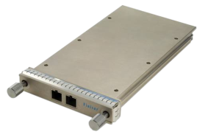
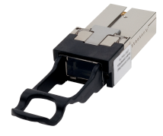
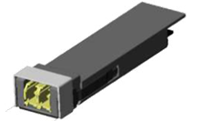
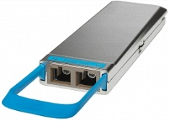
100 GbE Module Evolution
Each Module Increases Density, While Reducing Cost and Power
Generation | 1st Generation |  | 2nd Generation
Year Available | 2010 | 2010 | 2013 | 2015 | 2014
Electrical Signaling | CAUI 10 x 10 Gbps | CPPI 10 x 10 Gbps | CAUI 10 x 10 Gbps CAUI-4 4 x 25 Gbps | CAUI-4 4 x 25 Gbps | CAUI-4 4 x 25 Gbps
Front Panel Capacity | 4 Ports | 12 Ports | 8 –10 Ports | 16/32 Ports | 22/44 Ports
Industry Standard Path | CFP (82 mm Wide) | CXP MMF (27 mm Wide) | CFP2 (41.5 mm Wide) | CFP4 (21.5 mm Wide) | QSFP28 MMF (18.35 mm)
Cisco Proprietary Path |  |  | CPAK (35 mm Wide) | ? | ?

Slide 10
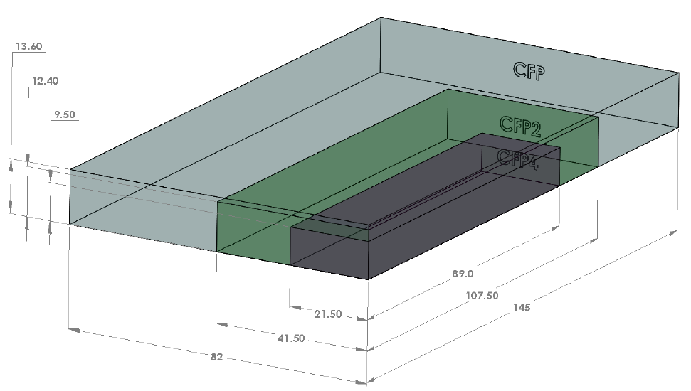
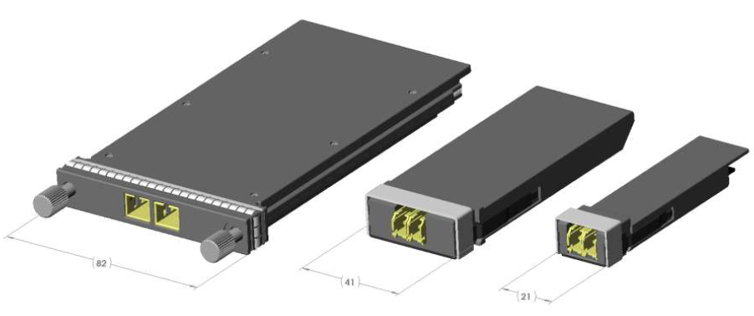
CFP Module Evolution
Graphical View of Module Form Factors

Slide 11
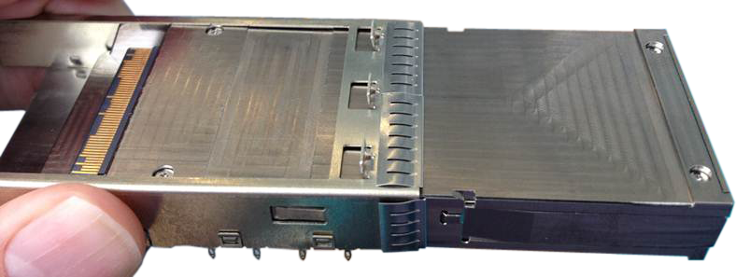
CFP2 Media Module
External universal gearbox converts electrical signaling so that all current IEEE and MSA standards can be supported in the CFP2 module
Specification is technically stable and manufacturing started in August 2012
CFP2 supports 10 electrical lanes that can run at multiple speeds
  10 x 10 Gbps lanes
  8 x 25 Gbps lanes
Smaller size and lower cost, complexity and power consumption than the CFP
10 X 10 Gbps
or
4 X 25 Gbps
ASIC
10:4
4:10
External Gearbox
CFP2
100GBASE-SR10
100GBASE-SR4
100GBASE-LR4
100GBASE-ER4
10x10-2km
10x10-10km
10x10-40km
CAUI or CAUI-4
CAUI or CAUI-4

Slide 12
Recent 100 GbE Developments
2nd generation projects based on 4 x 25 Gbps electrical signaling have started and are expected to be available in 2014+
IEEE P802.3bj 100 Gb/s Backplane and Copper Cable Task Force started in September, 2011
  100GBASE-KR4: 4 x 25 Gbps NRZ 35 dB at 12.9 GHz backplane
  100GBASE-KP4: 4 x 25 Gbps PAM-4 33 dB at 7 GHz backplane
  100GBASE-CR4: 4 x 25 Gbps over 5 m copper twinax cable
  Task Force web page: http://www.ieee802.org/3/bj/
  Standard expected in March, 2014

Slide 13
Recent 100 GbE Developments
IEEE P802.3bm 40 Gb/s and 100 Gb/s Operation Over Fiber Optic Cables Task Force started in August, 2012
  40GBASE-ER4: 4 x 10 Gbps over 40 km SMF
  100GBASE-SR4: 4 x 25 Gbps over 100 m OM3?/OM4 parallel MMF
  CAUI-4: electrical signaling to the CFP2, CFP4 and QSFP28
  Task Force web page http://www.ieee802.org/3/bm/
  Standard expected in March, 2015

Slide 14
100 GbE Technology Generations
CFP
CFP2
1st Generation: 10 Gbps Electrical Signaling Developed in 2010 More expensive, higher complexity and power consumption Lower port density supports 400 Gbps/slot Optical Interfaces: 100GBASE-SR10 10x10-2km 100GBASE-LR4 10x10-10km 100GBASE-ER4 10x10-40km |  |  | 2nd Generation: 25 Gbps Electrical Signaling CFP2 supports both CAUI and CAUI-4 CFP4 and QSFP28 only support CAUI-4 Expected in 2013 – 2015 Less expensive, lower complexity and power consumption Higher port density supports 800 Gbps/slot Optical Interfaces: 100GBASE-SR4 100GBASE-SR10 10x10-2km 100GBASE-LR4 10x10-10km 100GBASE-ER4 10x10-40km
ASIC
CFP2
Gearbox
CFP
CFP2
CAUI
10 x 10 Gbps Electrical
CAUI
10 x 10 Gbps Electrical
CFP2
CFP
CFP2
Gearbox
CFP2
CAUI-4
4 x 25 Gbps Electrical
CFP2
CFP
CFP2

Slide 15
100 GbE Technology Reference
 | 1st Generation IEEE
 | 1st Generation 10x10 MSA
 | 2nd Generation IEEE
Physical Layer Reach | Back-plane | 5 m Copper Cable | 7 m Copper Cable | 100 m OM3?/ OM4 MMF | 100 m OM3, 150 m OM4 MMF | 500 m SMF | 2 km SMF | 10 km SMF |  | 40 km SMF
Name | 100GBASE-KP4 and 100GBASE-KR4 | 100GBASE-CR4 | 100GBASE-CR10 | 100GBASE-SR4 | 100GBASE-SR10 | 100GBASE-PSM4 | 10x10- 2km | 10x10-10km | 100GBASE-LR4 | 10x10-40km | 100GBASE-ER4
Standard Status | 2014 IEEE 802.3bj | 2014 IEEE 802.3bj | June 2010 IEEE 802.3ba | 2015 IEEE 802.3bm | June 2010 IEEE 802.3ba | 2014 PSM4 MSA | March 2011 10x10 MSA | August 2011 10x10 MSA | June 2010 IEEE 802.3ba | August 2011 10x10 MSA | June 2010 IEEE 802.3ba
Electrical Signaling (Gbps) | 4 x 25 PAM-4 and NRZ | 4 x 25 | 10 x 10 | 4 x 25 | 10 x 10 | 4 x 25 | 10 x 10 | 10 x 10 | 10 x 10 | 10 x 10 | 10 x 10
Media Signaling (Gbps) | 4 x 25 | 4 x 25 | 10 x 10 | 4 x 25 | 10 x 10 | 4 x 25 | 10 x 10 | 10 x 10 | 4 x 25 | 10 x 10 | 4 x 25
Media Type | Backplane | Twinax | Twinax | Parallel MMF | Parallel MMF | Parallel SMF | Duplex SMF | Duplex SMF | Duplex SMF | Duplex SMF | Duplex SMF
Media Module | Backplane | CFP2, CFP4, CPAK, QSFP28 | CFP, CXP | CFP2, CFP4, CPAK, QSFP28 | CFP, CFP2, CPAK, CXP | CFP2, CFP4, CPAK?, QSFP28 | CFP, CFP2 | CFP, CFP2 | CFP, CFP2, CFP4, CPAK | CFP, CFP2? | CFP, CFP2?
Availability | 2014+ | 2014+ | 2010 | 2015+ | 2012 | 2014+ | 2011 | 2011 | 2010 | 2012 | 2012

Slide 16

Industry Challenges for 100 GbE and Beyond
All Solutions are Good, Fast, or Cheap – Pick Any Two
£
Form
Factor
Transit/
Transport
Internet
Exchanges
Optical
Signaling
Electrical
Signaling
Broadband
Data Center
/Cloud
Content
Technical Feasibility
Market Requirements
Economics Dictate the Solution
IEEE Provides an Open Industry Forum to Make Decisions

Slide 17
Bandwidth Requirements Projection
Terabit Link Capacities are Needed Soon
Diagram source: http://www.ieee802.org/3/hssg/public/nov07/HSSG_Tutorial_1107.zip

Slide 18
Why 400 GbE? Why not TbE?
Given that TbE is technically and economically impractical to develop until 2020+ we had to make a choice
  Wait… for >10 years between Ethernet speed increases (100 GbE June 2010)
IEEE 802.3 Ethernet Bandwidth Assessment (BWA) Ad Hoc and the IEEE 802.3 Higher Speed Ethernet (HSE) Consensus Ad Hoc spent a lot of time analyzing market demand and technical options
High degree of consensus in the IEEE that 400 GbE should be the next Ethernet speed
  CFI straw poll: yes 132, no 0, abstain 1
  Motion for Study Group: yes 87, no 0, abstain 4
400GbE will make the standardization process faster compared to 802.3ba
  IEEE 802.3 Higher Speed Study Group first had to analyze market demand and technical options
  Eventually decided on 40 GbE and 100 GbE

Slide 19
Theoretical M (1000) Form-factor Pluggable
Using Today’s Technology is Impractical
MFP
6 in.
10 in.
CFP2
4 x 25 Gbps Electrical Channels
1.63 in. x 4.23 in. (6.9 sq. in.)
12 W Power for 100GBASE-LR4
CFP2
Theoretical MFP
40 x 25 Gbps Electrical Channels
6 in. x 10 in. (60 sq. in.)
120 W Power
4.23 in.
1.63 in.
Using current technology 25 Gbps electrical signaling, a TbE module (MFP) would use 40 channels
The size of the module can be estimated at ½ sq. in. per W of power consumed
If a CFP2 module consumes 12 W, then the MFP could consume 120 W
This would require 60 sq. in. to cool and could make the module 6 in. by 10 in., taking up over 25% of the board space

Slide 20
IEEE 802.3 400 Gb/s Ethernet Study Group
400 GbE Study Group approved on March 22, 2013
  400 GbE Study Group will define the objectives for reach and media that could
  Re-use 100GbE technology
    4X100GBASE-SR4 – 100 meters on 16 parallel MMF
    4X100GBASE-LR4 – 10km on 8 parallel SMF
  Create new 400GbE technology that could delay the standard after 2016
    400GBASE-LR16 – 2 km on duplex SMF
  400 GbE standard expected in 2016
Study Group web page http://www.ieee802.org/3/400GSG/
First interfaces expected to be available in 2016+

Slide 21
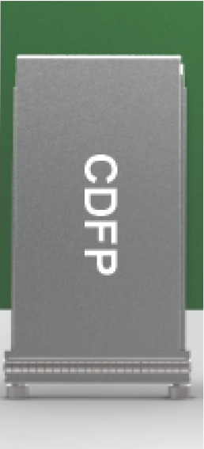
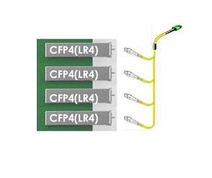


400 GbE Module Evolution Estimates
Each Module Increases Density, While Reducing Cost and Power
 | 1st Generation |  | 2nd Generation | 3rd Generation
Year | 2016 | 2016 | 2019+ | 2022+
Electrical Signaling | CDAUI-16 16 x 25 Gbps | CDAUI-16 16 x 25 Gbps | CDAUI-8 8 x 50 Gbps | CDAUI-4 4 x 100 Gbps
Media Module | CDFP | 4 x CFP4 | CDFP2 | CDFP4
Images courtesy of TE Connectivity.

Slide 22
400 GbE CDFP Module Overview
The CDFP MSA will define a specification for a module and the supporting hardware for a high-density 400 Gigabit Ethernet (400 GbE) based on 16 x 25 Gbps signaling
  CD = 400 in Roman numerals, C = 100 and D = 500
  FP = Form-factor Pluggable, follows the naming convention started in 1999 with the SFP – Small Form-factor Pluggable
  MSA = Multi-Sourcing Agreement, a legal document that defines a group that will define a specification for how to make and license the technology
Optical Interface
With Two 16 Fiber Ribbons
(16 Transmit Fibers + 16 Receiver Fibers)
Electrical Interface
16 x 25 Gbps in Each Direction
Image courtesy of the CDFP MSA.
Prototype CDFP Module

Slide 23
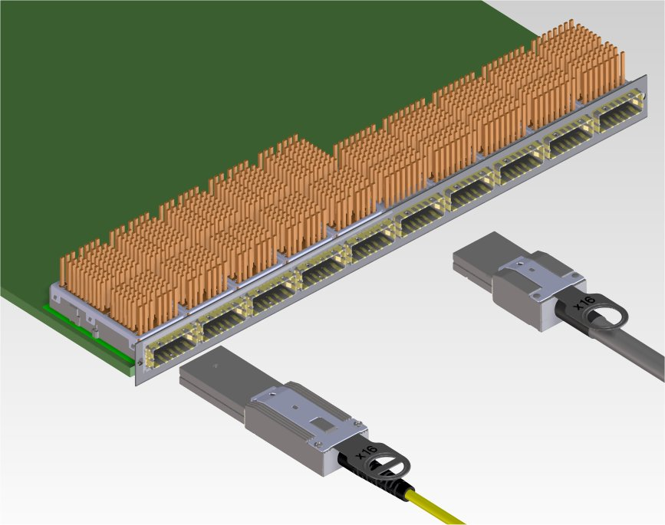
CDFP Switch Overview
The CDFP module will be defined to support about 10 CDFP’s in a 1 RU (19”) switch or modular switch blade to yield 4 Tbps of throughput
4 Tbps Slot Capacity
(10 x 400GbE) vs.
400 Gbps Today
(4 x 100 GbE or
48 x 10 GbE)
Style 1 – Low Power for copper applications
Style 2 – Higher Power for fiber and copper applications
Image courtesy of the CDFP MSA.

Slide 24
More Information
IEEE 802.3 Industry Connections Ethernet Bandwidth Assessment Ad Hoc
  http://www.ieee802.org/3/ad_hoc/bwa/index.html
IEEE 802.3 Industry Connections Higher Speed Ethernet Consensus Ad Hoc
  http://www.ieee802.org/3/ad_hoc/hse/public/index.html
IEEE 400 GbE Call-For-Interest presentation
  http://www.ieee802.org/3/cfi/0313_1/CFI_01_0313.pdf
IEEE 802.3 400GbE Study Group
  http://www.ieee802.org/3/400GSG/index.html

Slide 25
Ethernet Industry Summary
10 GbE is being widely deployed to servers today and driving the need for 40 GbE and 100 GbE in data centers
40 GbE is mature QSFP+ technology and will be available in a smaller form-factor in the future
100 GbE is still a couple of generations away from serial signaling
  25 Gbps signaling is challenging
400 GbE is just starting and should leverage 100 GbE or the standard will slow down to beyond 2016
TbE is still science fiction from a low cost and low power perspective, but give it some time (2020+)

Slide 26
Thank You

